Slide 1
JDK and Eclipse Installation

Slide 2
Java JDK and IDE
Java is a programming language. The JDK is a development environment for building applications, applets, and components using the Java programming language.
Eclipse is the IDE of Java. IDE is short for Integrated development environment which provides comprehensive facilities to computer programmers for software development.

Slide 3
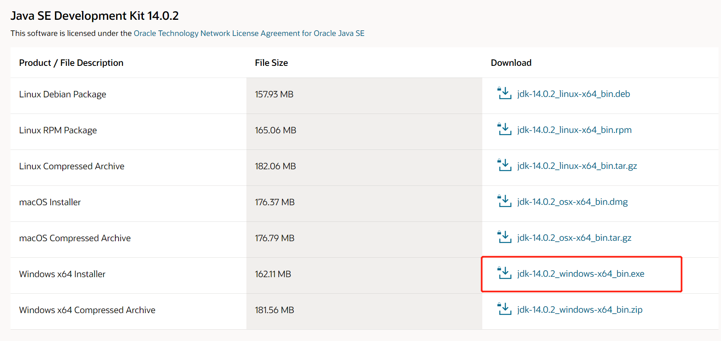
Install JDK
Go to https://www.oracle.com/java/technologies/javase-jdk14-downloads.html, and the windows installer to download.

Slide 4
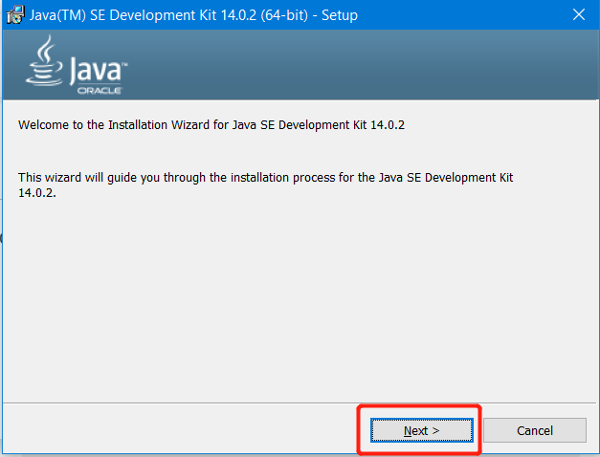
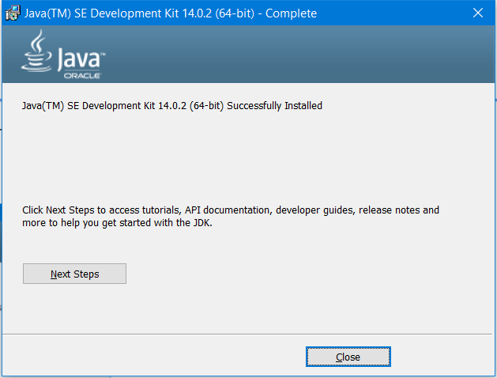
Install JDK
Click the .exe file you just downloaded and following the instructions to install the JDK, you should get the following result.

Slide 5
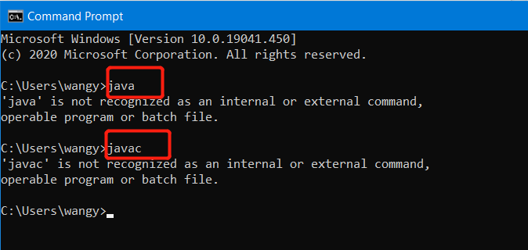
Set the system path for the java
After successfully installed the JDK, it is highly recommended to set the system path for java
Usually if you have not configured the environment variables before, when you type java/javac in command prompt, it looks like this

Slide 6
Set the system path for the java
In the windows start menu, type `environment variables`, you should get the following dialog.

Slide 7
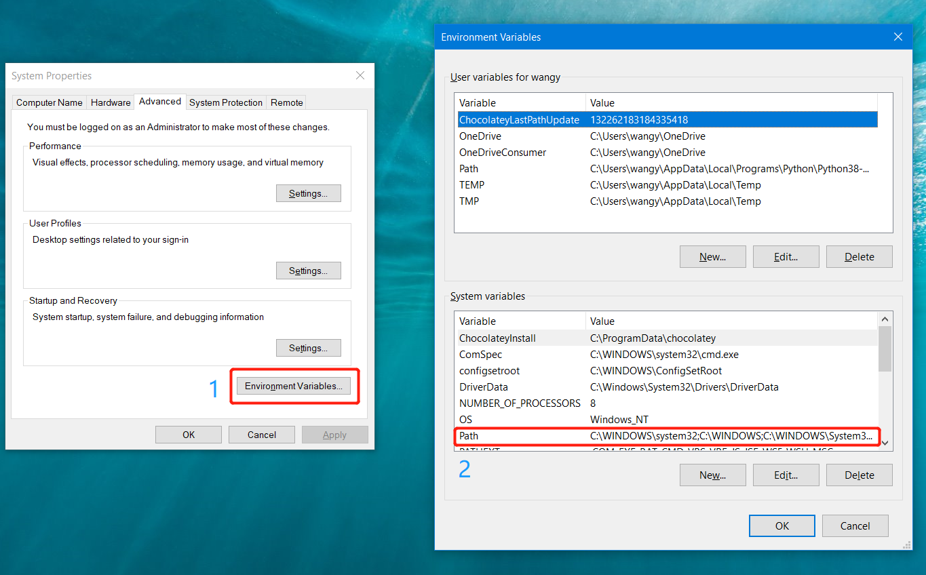

Slide 8
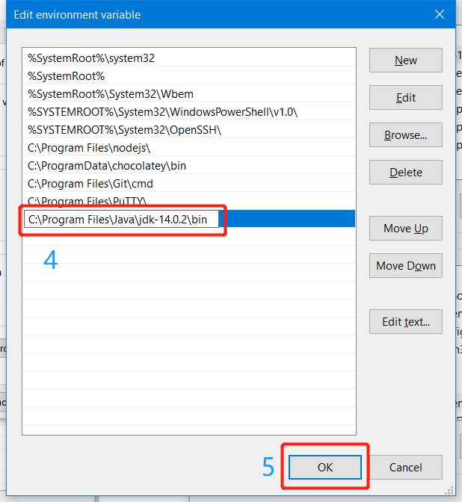
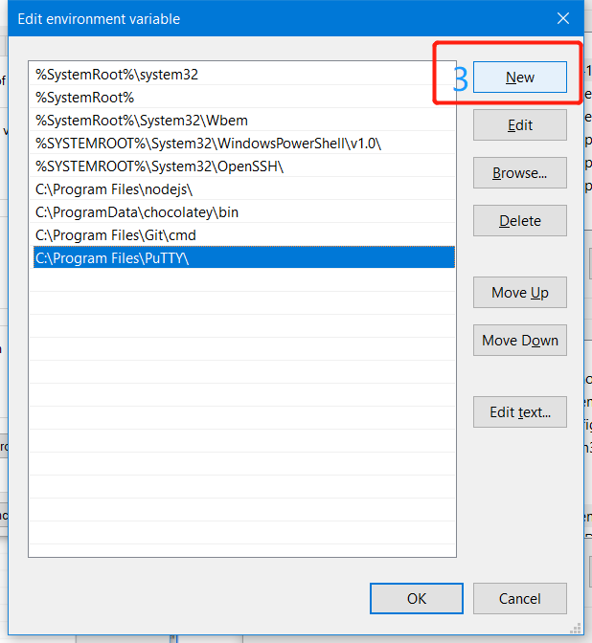
Type ‘C:\Program Files\Java\jdk-14.0.2\bin’ in the new section and hit OK
Note: In the Step 4, it depends on where you installed your JDK, if the path is default when you installed the JDK, it should be the same as me.

Slide 9
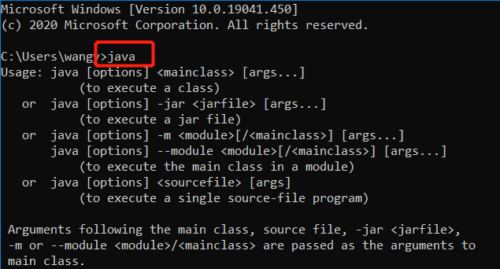
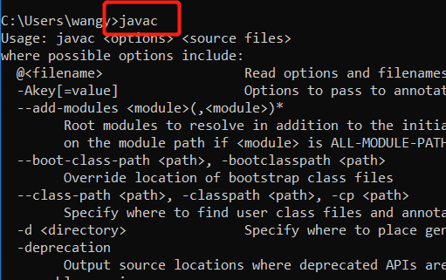
Test your JDK
Now you should have global variable name ‘java’ as the ‘global environment variables’. To test it, open your ‘Command Prompt’ and type `java` or `javac`, you should get the following

Slide 10
Your first java code
Create a new folder under your desktop called ‘Hello’
Create a new file ‘HelloWorld.java’ under the newly created folder
Open this ‘HelloWorld.java’ by text for example `Notepad` which is already installed in windows.
Copy the following code:
public class HelloWorld {
public static void main(String[] args) {
System.out.println("Hello World!");
}
}

Slide 11
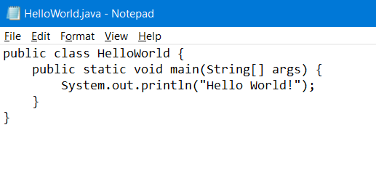

Slide 12
Compile your HelloWorld.java
CD(Change Directory) your Command Prompt into your new foler `Hello`
Note: My path is like this `C:\Users\wangy\Desktop\Hello`, I assume the only difference between my path and your path is the user name. So the general case of the path (if you create the folder under Desktop) is like this
C:\Users\your_user_name\Desktop\Hello
Type `javac HelloWorld.java` (javac means ‘java compile’)
Type `java HelloWorld` (run the compiled java code)
You can see the result of your first java code!!!

Slide 13
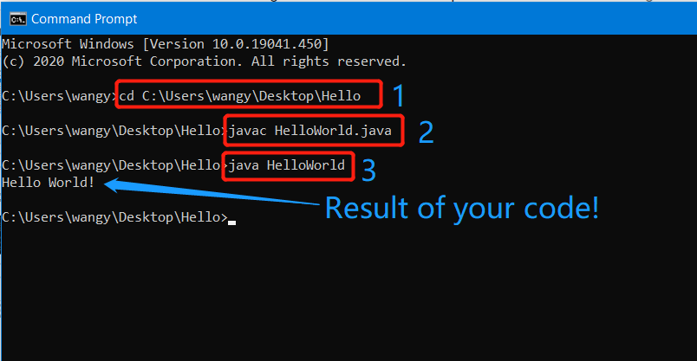

Slide 14
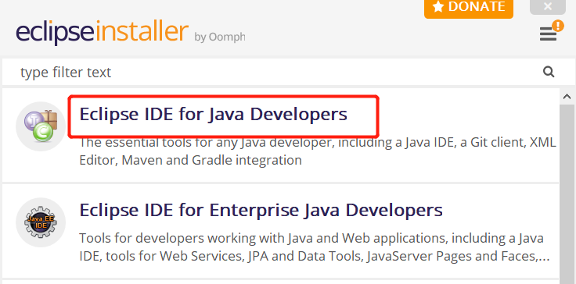
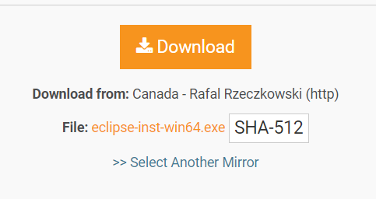
Installation of Eclipse
Go to https://www.eclipse.org/downloads/download.php?file=/oomph/epp/2020-06/R/eclipse-inst-win64.exe and download Eclipse and install.
Click Eclipse IDE for JAVA DEVELOPERS when installing Eclipse

Slide 15
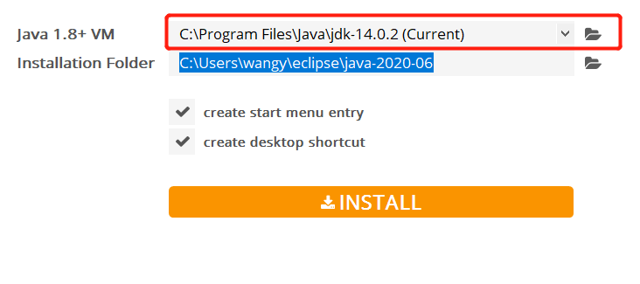
Usually Eclipse will find your installed JDK automatically. Like the following.
If Eclipse did not find it correctly, you have to do it manually by click the ‘FOLDER’ icon.
Click INSTALL to continue if everything looks fine.

Slide 16
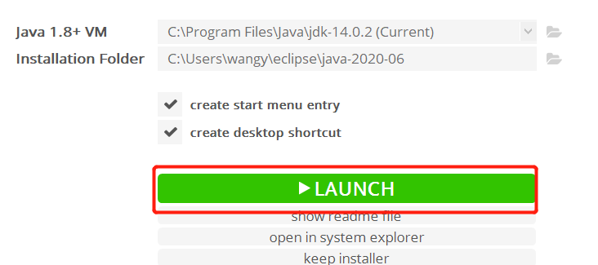
Launch Eclipse
After successfully installed your Eclipse, you should see this and let’s LAUNCH it!

Slide 17
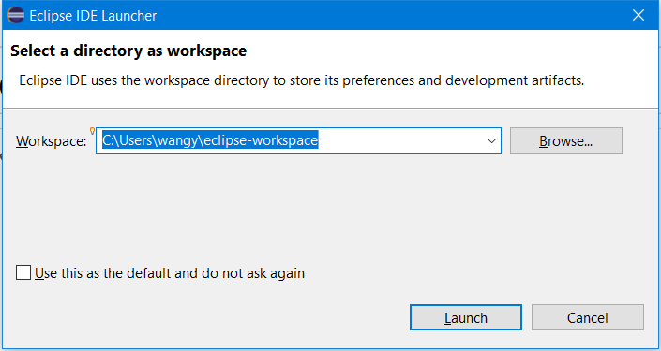
Eclipse may asks you to set workspace. Leave it as default.

Slide 18
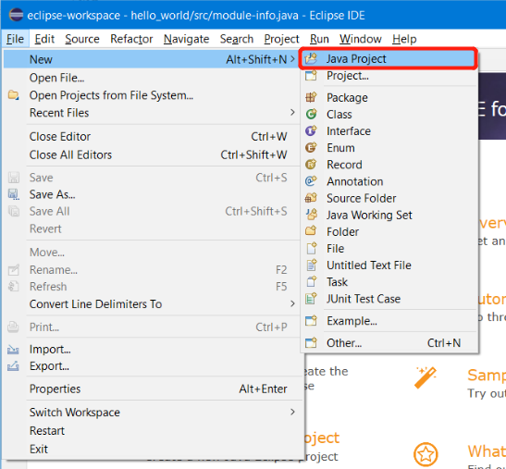
Create your first Project
File => New => Java Project

Slide 19
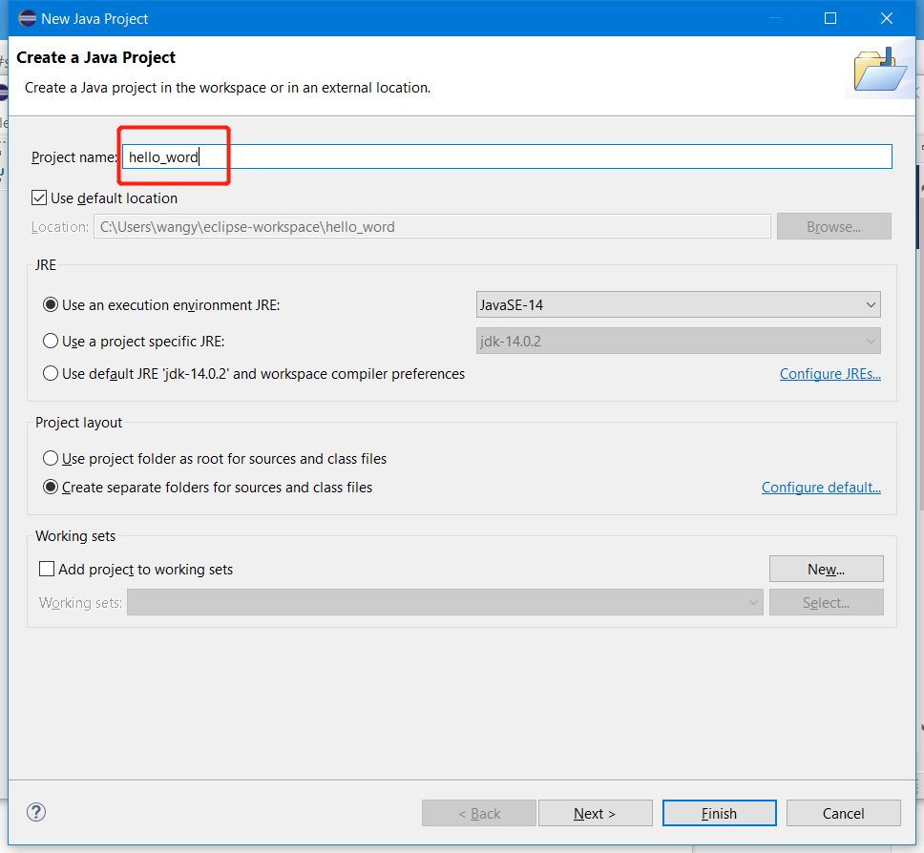
Create your hello_world
Project
Click finish and you have
already created a java project
Called `hello_world`

Slide 20
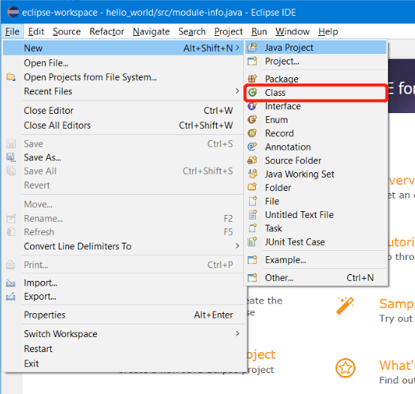
Create class
File => New => Class

Slide 21
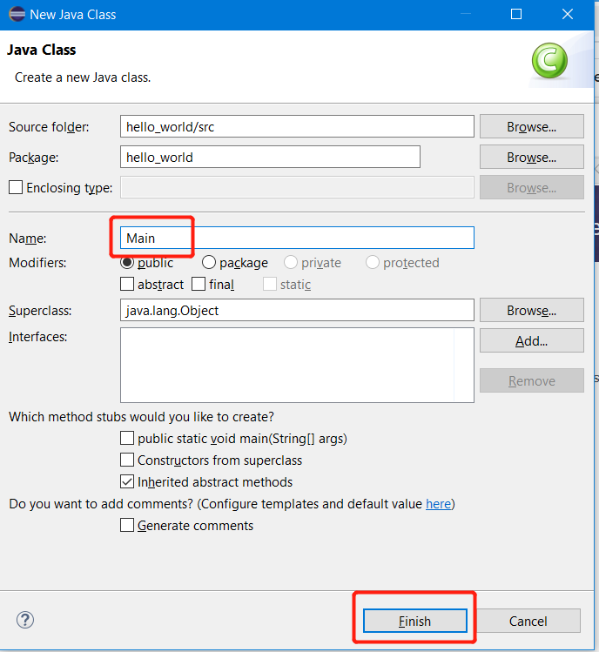
Create class
You can call your created class
`Main` and click finish

Slide 22
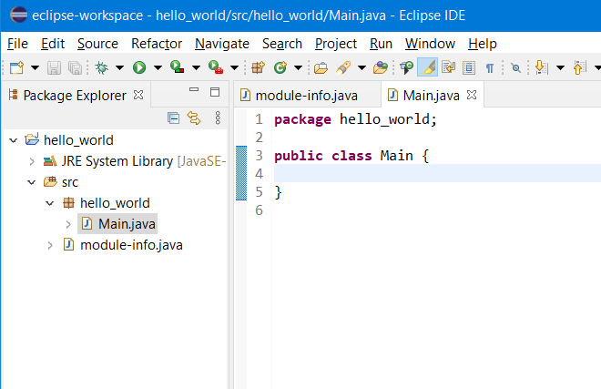
Type in your own code
You can type in your code
In the Main class

Slide 23
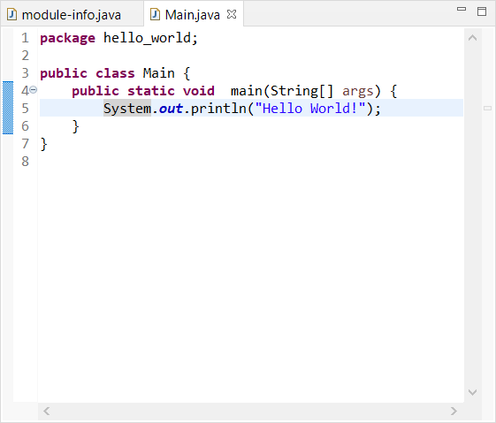

Slide 24
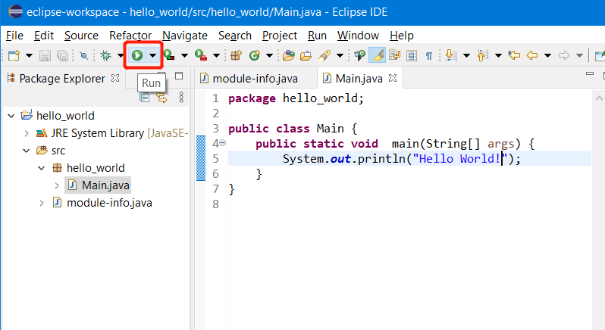
Compile and run

Slide 25
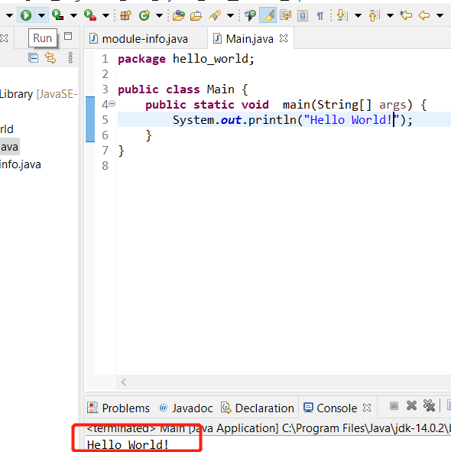
DONE!

